Slide 1
Group Term Project
Myles Moore, Sean Wright, Sudina Thapaliya, Janee Lewis, Joshua Harrell

Slide 2
Problem Statement
It’s hard to understand what really happens inside a computer network when data moves from one place to another, especially since most modern tools hide the low-level details. To get real hands-on experience, our team is building a small network simulation in C++/terminal that shows how packets are created, routed, and controlled during transmission.
Our project is organized into a clean structure with components like Main, Packet, RoutingTable, NetworkSimulator, and FlowControl, each handling a different part of the process—everything from generating packets with checksums to routing decisions and flow control using Stop-and-Wait and Sliding Window techniques. We’re coding the entire project in vi/vim and using Make with a custom Makefile to build and run it in the FreeBSD environment.
Overall, this project helps us better understand how low-level network operations actually work while also proving that we can manage a full systems-level workflow without relying on any modern IDEs.

Slide 3
Goal of our Project
To simulate basic network operations
To demonstrate our proficiency in developing in C++.
Using the vi/vim text editor for all code editing and modifications.
Utilizing Make and your custom Makefile to compile, clean, and run your project within the FreeBSD terminal environment.

Slide 4
Project Structure
Networking-Stack-Simulation-main/
├── bin/ # Compiled .class files (output directory)
│ └── network/
│ ├── FlowControl.class
│ ├── FlowControlTest.class
│ ├── Main.class
│ ├── MainTest.class
│ ├── NetworkSimulator.class
│ ├── NetworkSimulatorTest.class
│ ├── Packet.class
│ ├── PacketTest.class
│ ├── RoutingTable.class
│ └── RoutingTableTest.class
├── libs/ # External libraries for testing
│ ├── hamcrest-core-1.3.jar
│ └── junit-4.13.2.jar
├── src/
│ └── network/
│ ├── FlowControl.java # Flow control algorithms (Stop-and-Wait, Sliding Window)
│ ├── Main.java # Entry point and demonstration
│ ├── NetworkSimulator.java # Core network simulation (sends/routs packets)
│ ├── Packet.java # Packet representation with checksum
│ └── RoutingTable.java # Simple routing table abstraction
└── test/
└── network/
├── FlowControlTest.java # JUnit tests for flow control
├── MainTest.java # JUnit tests for demo behavior
├── NetworkSimulatorTest.java
├── PacketTest.java
└── RoutingTableTest.java

Slide 5
Component Overview
Main - Creates packets, routes them and triggers flow control
Packet - Represents a data packet w/ checksum
RoutingTable - Stores destination, next hop mappings
NetworkSimulator - Handles routing and transmission
FlowControl - Implements Stop-and-Wait + Sliding Window

Slide 6
Design Overview
Our project is designed to give a clearer, hands-on look at how basic network operations actually work by breaking the system into several simple components that each handle a specific part of the networking process. The structure is intentionally modular, so each class focuses on one task while still interacting with the others to simulate a complete data-transfer pipeline.
The program starts in Main, where packets are created and the simulation is triggered. Each packet is represented by the Packet class, which stores core information like data, destination, and a checksum to mimic basic error detection. Once a packet is generated, it is passed to the NetworkSimulator, which acts as the central controller for the entire workflow. The simulator checks the RoutingTable, a small, custom mapping of destinations to next hops, to determine how the packet should move through the network.

Slide 7
Design Overview cont'd…
As the packet is routed, the FlowControl component manages how packets are actually transmitted. We implemented two classic algorithms, Stop-and-Wait and Sliding Window so the user can see the difference between simple and more efficient flow control methods. Stop-and-Wait sends one packet at a time, while Sliding Window allows multiple packets to be in transit at once, which better reflects modern networking behavior.
All components work together to simulate a basic but realistic networking workflow. The design keeps each task separate (packet creation, routing, flow control), which not only helps us understand each part individually but also makes the overall system easier to test, debug, and extend. By building and running this simulation completely in vi/vim with Make on FreeBSD, we also reinforce real systems-level development practices throughout the project.

Slide 8
Main.java
Acts as the entry point to the entire application
Creates a NetworkSimulator
Defines routing rule (dest=2 → nextHop=99)
Builds a packet & verifies checksum
Sends packet through routing system
Demonstrates both flow-control methods
public static void main(String[] args) {
NetworkSimulator simulator = new NetworkSimulator();
simulator.addRoute(2, 99);
Packet p = new Packet(1, 2, "Hello, Node 2!");
System.out.println("Checksum valid? " + p.verifyChecksum());
simulator.sendPacket(p);
FlowControl fc = new FlowControl();
fc.stopAndWait(p);
fc.slidingWindow(new Packet[]{ ... }, 2);
}
Main.java ties all system components together.

Slide 9
Packet.java
Stores:
Source address
Destination address
Payload string
Checksum (for integrity verification)
Key Method:
verifyChecksum()
Ensures packet has not been corrupted

Slide 10
RoutingTable.java
Holds routing entries in a HashMap
Maps destination -> nextHop
Primary Operations:
addRoute(int dest, int nextHop)
lookup(int dest)
If unknown = returns -1 (No route)

Slide 11
FlowControl.java
Two transport-layer reliability mechanisms:
1. Stop-and-Wait
One packet sent → must ACK before next
Simple, reliable, but slow
2. Sliding Window
Multiple packets sent before ACK required
Faster throughput
Efficient for real network flow

Slide 12
NetworkSimulator.java
Responsible for packet transmission & routing
Functions:
Add routing entries
Forward packets via next hop lookup
Display routing decision results

Slide 13
Output Example
Checksum valid? true
Packet from 1 to 2 routed via 99
Sending packet: Hello, Node 2!
Waiting for ACK...
ACK received for packet.
Sending packet: Packet A
Sending packet: Packet B
ACKs received for window.
Sending packet: Packet C
ACKs received for window.

Slide 14
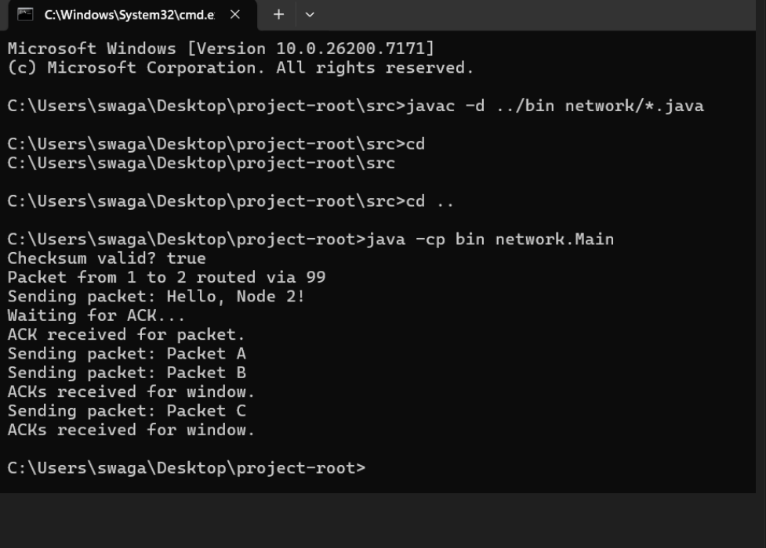
Screenshot of output

Slide 15
Running the Program
Compile:
javac -d bin src/network/*.java
Run:
java -cp bin network.Main

Slide 16
Junit test Commands
Commands for testing functionality of each Test.java file (Run these commands in project root)
java -cp "bin;libs/junit-4.13.2.jar;libs/hamcrest-core-1.3.jar" org.junit.runner.JUnitCore network.MainTest
java -cp "bin;libs/junit-4.13.2.jar;libs/hamcrest-core-1.3.jar" org.junit.runner.JUnitCore network.PacketTest
java -cp "bin;libs/junit-4.13.2.jar;libs/hamcrest-core-1.3.jar" org.junit.runner.JUnitCore network.RoutingTableTest
java -cp "bin;libs/junit-4.13.2.jar;libs/hamcrest-core-1.3.jar" org.junit.runner.JUnitCore network.NetworkSimulatorTest
java -cp "bin;libs/junit-4.13.2.jar;libs/hamcrest-core-1.3.jar" org.junit.runner.JUnitCore network.FlowControlTest
Command to run every Test.java file at once
java -cp "bin;libs/junit-4.13.2.jar;libs/hamcrest-core-1.3.jar" org.junit.runner.JUnitCore network.MainTest network.PacketTest network.RoutingTableTest network.NetworkSimulatorTest network.FlowControlTest

Slide 17
Link to project github repository
https://github.com/Dollablozzy/Network-Simulator

Slide 18
Summary
Implemented Packet creation & checksum validation
Routing table for network forwarding
Network simulator for packet transmission
Stop-and-Wait + Sliding Window flow control
Demonstrates core networking principles through Java simulation

Slide 19
Conclusion Future Improvements
The Networking Stack Simulation demonstrates the foundational concepts behind packet-based communication in computer networks through a clean and modular Java implementation. By modeling packets, routing tables, simulators, and flow control protocols, the project provides a clear, hands-on understanding of how data travels across a network and what mechanisms ensure reliable delivery.
Although simplified, the system captures the essence of real-world behaviors—such as checksum validation, next-hop routing, and the difference between Stop-and-Wait and Sliding Window protocols. Its structure makes it suitable for classroom demonstrations, student labs, and introductory exploration of networking principles. The included JUnit tests also help reinforce good development practices and ensure correctness of the underlying logic.
Overall, this project achieves its goal of illustrating the relationship between packets, routing, and flow control while leaving plenty of room for deeper experimentation.
Add Error Simulation
Introduce packet corruption, drops, and retransmission handling.
Enhance Flow Control
Implement realistic Sliding Window features such as sequence numbers, ACKs, and timeouts.
Support Multi-Hop Routing
Expand routing beyond a single next hop and simulate full network topologies.
Add Congestion Modeling
Include queueing, packet loss from overflow, and simple congestion control.
Create Visualization Tools
Provide a GUI or console visualization to show packet movement and window progression.

Slide 20
Team Contributions
Myles Moore - Source Code and Github Repository
Sean Wright - Presentation, Readme File, Github Repository
Janee Lewis - Test Cases, Presentation
Josh Harrell - Source Code, Makefile
Sudina Thapaliya - Readme File
We all provided each other a great deal of communication and collaboration. We all provided help to each other when needed so that we could complete the project efficiently.

Slide 21
Questions?
Ask Anything!

